Slide 1


Data Analytics Internship
By Shubham Gupta

Slide 2
Task 1- Netflix IMDb Score Analysis
Objective: Create an engaging Power BI or Tableau Dashboard analyzing Netflix shows’ IMDb scores. Visualize ratings, genres, and trends to derive insights into viewer preferences.

Slide 3
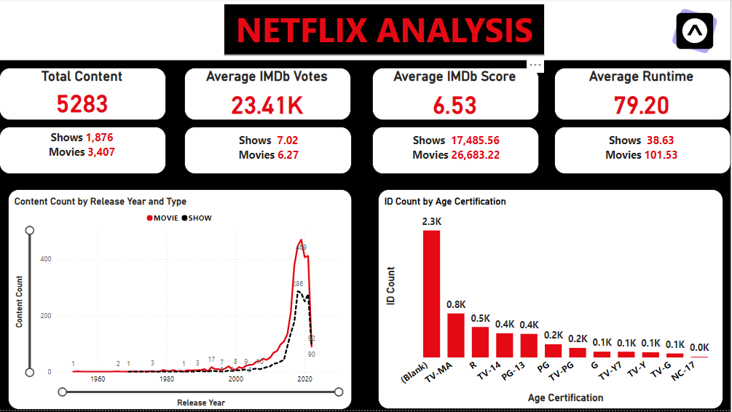

Slide 4
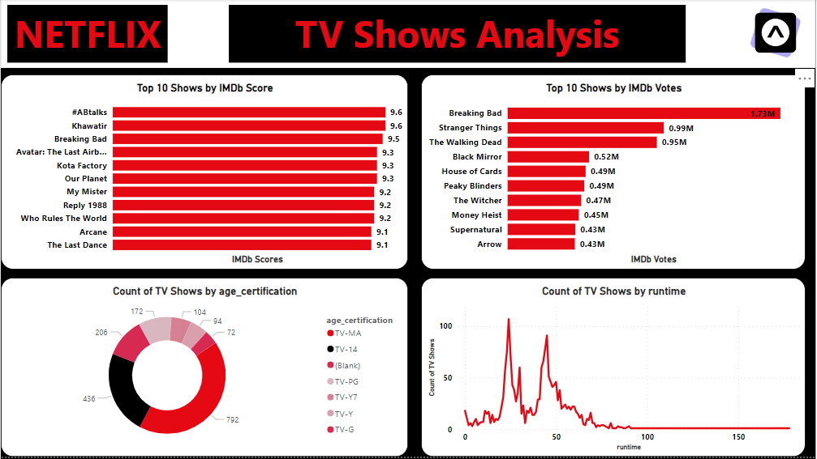

Slide 5
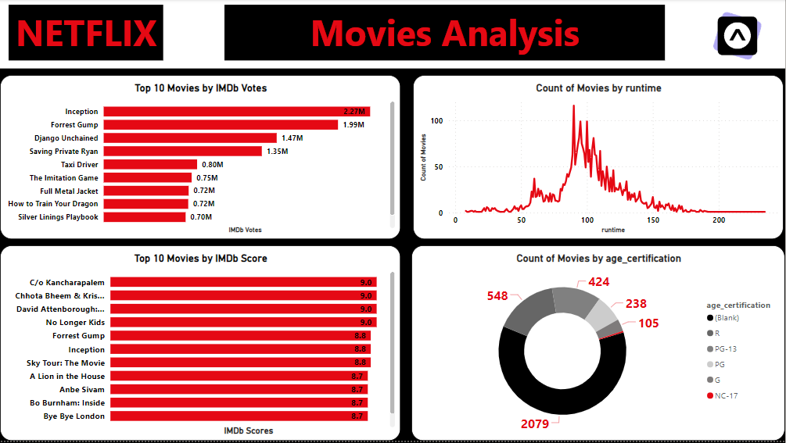

Slide 6
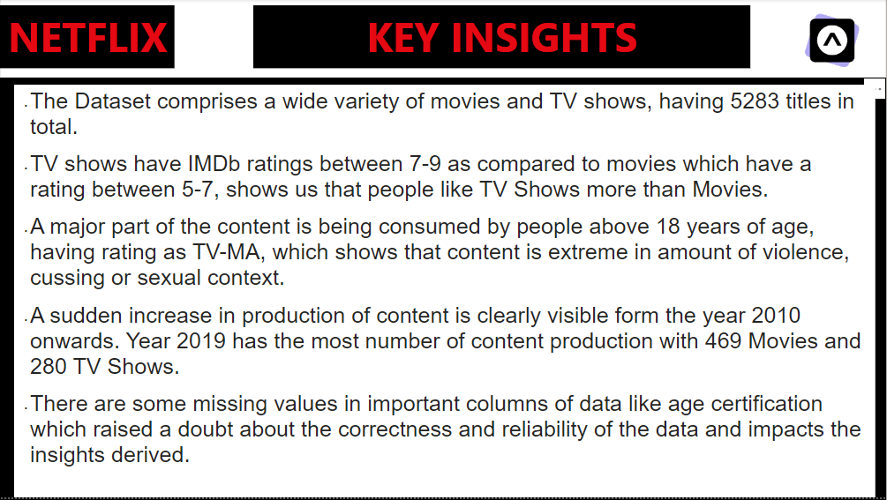

Slide 7
Task 4 - Real Time Space Mission Dashboard
Objective: Build a captivating Power BI or Tableau Dashboard using real time space mission data. Visualize mission details, launch frequencies, and success rates to offer comprehensive insights into space exploration activities.

Slide 8
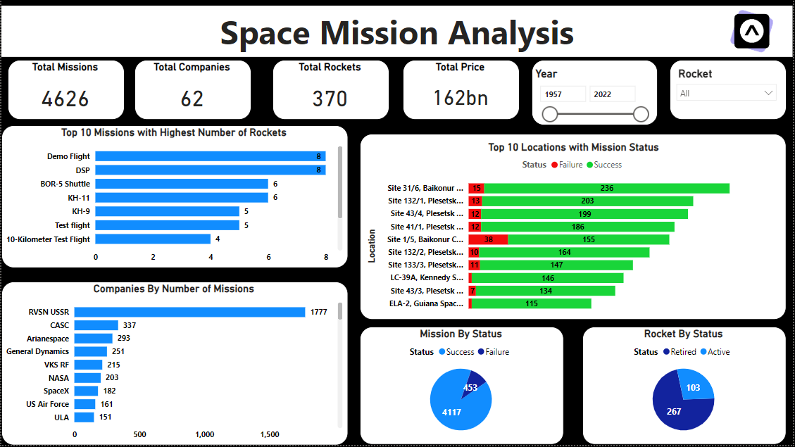

Slide 9
